Slide 1


Post-Conference Report
INA Growth Summit 2025
Charting the Future of Independent Networks

Slide 2
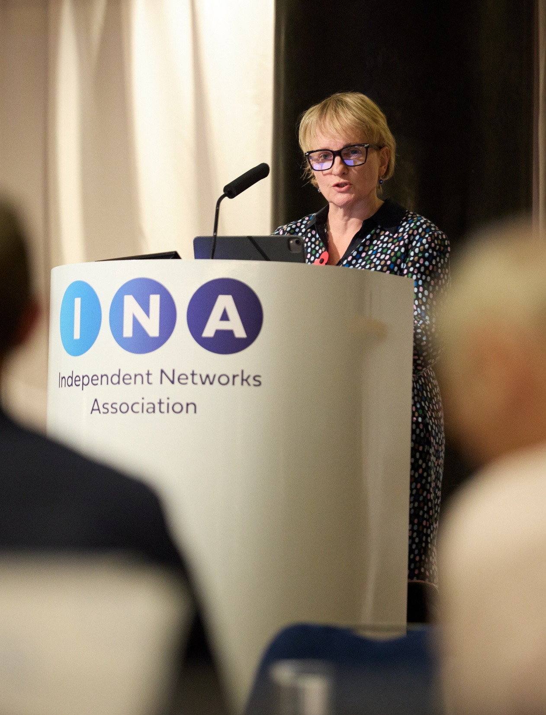
Introduction
Bringing the right people into the room
Over 70 leaders from independent networks, developers, investors, regulators, government, local authorities and advisers
Representation from electricity, gas, water, heat and digital connectivity
Focused on how independent networks can unlock the infrastructure the UK needs for housing, growth and net zero
Our aims for the day
Share insight on the policy and regulatory landscape
Test ideas with people delivering projects on the ground
Capture clear priorities for INA’s 2026 workplan and advocacy
Build relationships across sectors to help you deliver schemes more quickly and effectively

Slide 3

Key Learnings.
Government & Devolved Agenda
What we discussed
How policy and regulation are evolving across GB, devolved nations and regions
The increasing role of metro mayors, combined authorities and local plans in shaping infrastructure
The practical experience of IDNOs, IGTs and NAVs working with multiple incumbents and regulators
Key messages from you
Independent Water Companies (NAVs) still face disproportionate, site-by-site licensing and approvals, delaying major housing and mixed-use schemes
Differing technical standards and processes between incumbents add avoidable cost and complexity
Infrastructure decision-making is becoming more devolved – but independent networks are not always visible at those tables
You want the INA to provide a single, coherent voice across government, Ofgem, Ofwat and devolved/regional bodies

Slide 4
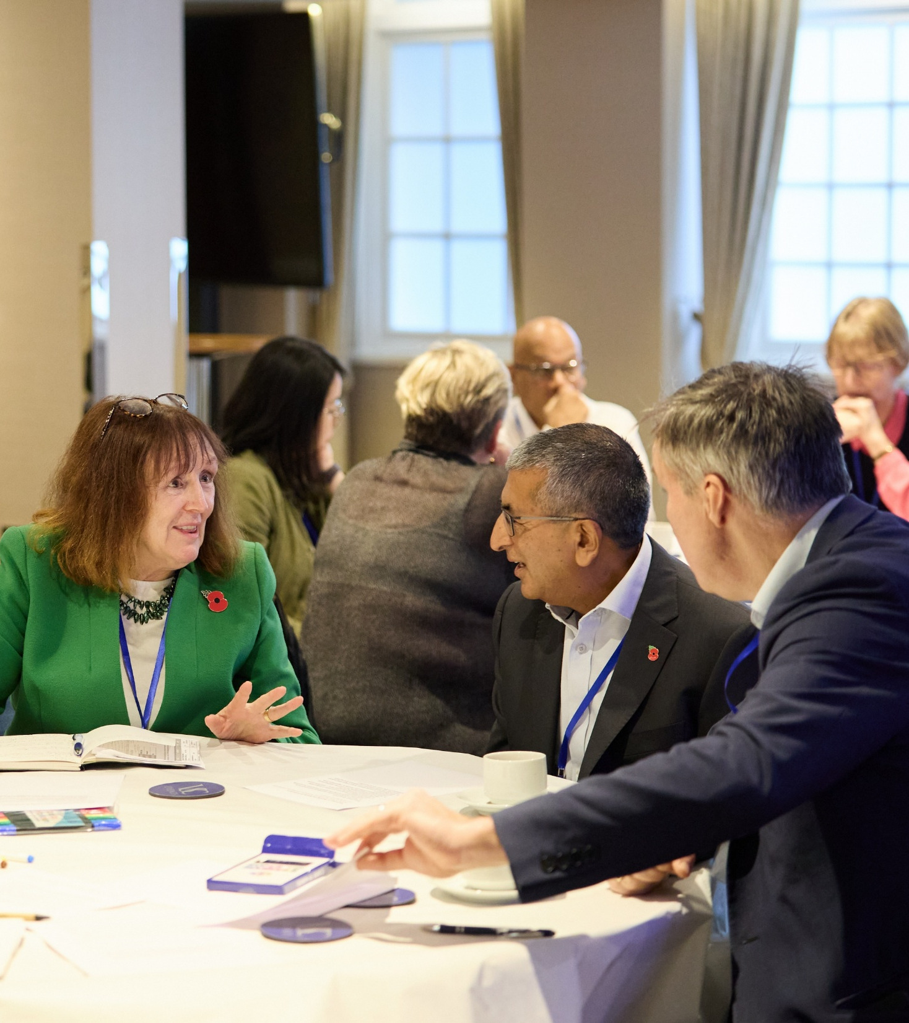
Key Learnings.
Sustainable Growth & Investment
What we discussed
How independent networks support housing delivery, regeneration and low-carbon infrastructure
The investment climate for new connections and multi-utility schemes
The impact of connections reform, charging structures and land rights on your projects
Key messages from you
There is strong appetite to invest – but uncertainty around connections, charging and land rights slows delivery
Developers and investors need earlier, clearer information on capacity, queues and likely timescales
Data centres, EV charging and heat networks are changing local system needs, creating new pinch points
Independent networks’ ability to provide multi-utility, GB-wide solutions is a major advantage – but not always recognised in planning and policy
What this means for your organisation
Developers and landowners can use independent networks to de-risk phasing and bring forward early stages of schemes
Network operators can differentiate by offering data-driven, whole-site offers, not just point-to-point connections
Investors can take confidence from a sector that is increasingly central to government objectives on housing and net zero

Slide 5
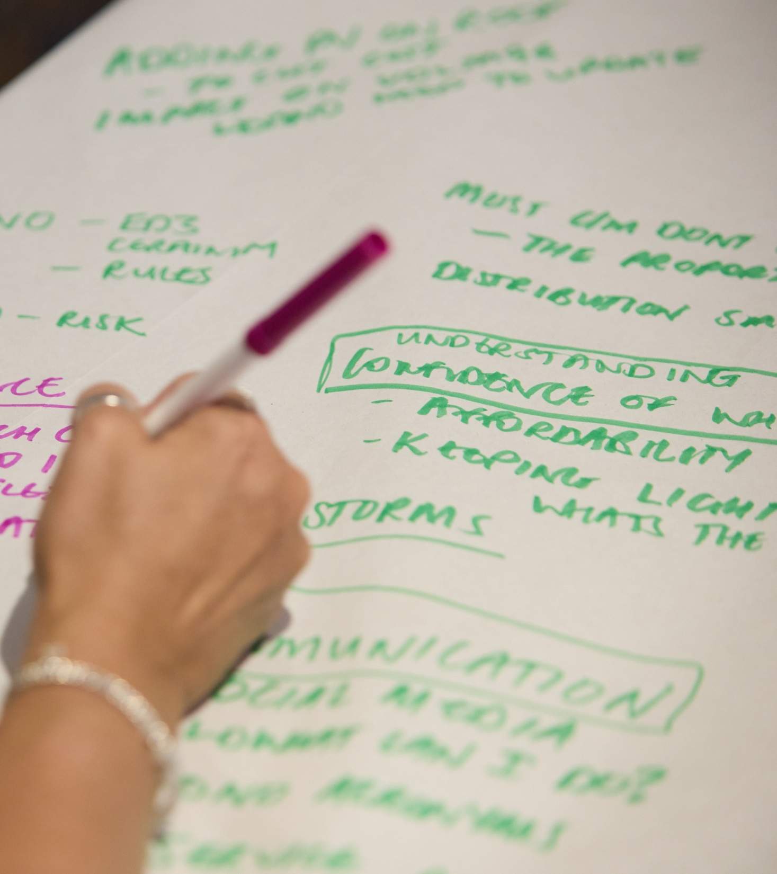
Key Learnings.
Customers & Strategic Resilience
What we discussed
How customer expectations are changing – particularly around communication and vulnerability
The widening definition of resilience: climate impacts, critical national infrastructure and system interdependencies
How independent networks already meet, and often exceed, existing standards
Key messages from you
Customers expect clear, proactive communication, especially during interruptions and planned works
Resilience now covers extreme weather, cyber risk, data centres, water scarcity and inter-utility dependencies
You want consistent minimum standards across all networks, so customers see the same level of service wherever they live
Better, GDPR-compliant data-sharing on priority services and vulnerability would help you support customers more effectively
What this means for your organisation
Investing in customer insight and communication is a core part of resilience, not an optional extra
Working with local authorities, housing providers and community groups can improve reach and trust in emergencies
Independent networks can use their agility to pilot new approaches – for example, multi-utility customer messaging and shared PSR support

Slide 6
From Summit Insights to INA’s 2026 Priorities
How your input is shaping our work
Based on what we heard at the Growth Summit, INA will focus on:
Regulatory consistency and proportionality
Campaigning for streamlined NAV licensing and simpler, aligned technical standards
Ensuring independent networks’ role is recognised in national and regional infrastructure plans
Connections reform and data transparency
Pushing for fair, predictable processes for demand as well as generation connections
Working with members to evidence the benefits of better queue and capacity data
Customer and resilience standards
Assessing our members against the INAs Customer Commitment framework on customer service, vulnerability and resilience and sharing best practice across the independent sector
Using member experience to inform regulatory approaches to resilience across utilities
Devolved and regional engagement
Building systematic relationships with metro mayors, combined authorities and local government
Positioning members as partners of choice for new housing, regeneration and low-carbon development

Slide 7
How Delegates Can Stay Involved
Keep the momentum going
Stay connected with INA
Follow our updates and consultations – sign up to our newsletter at ina.org.uk or follow us on LinkedIn.
Look out for follow-up roundtables and regional events in 2026. We’ll be sending out more information shortly.
Contact the INA team to discuss specific issues, ideas or opportunities to collaborate. Email us directly at info@ina.org.uk.
Share your evidence and case studies
Provide examples of projects where independent networks have unlocked housing, regeneration or low-carbon schemes
Engage regionally
Work with us to build relationships with devolved and regional bodies in your areas of operation
Thank you for contributing to the INA Growth Summit 2025 – your insight is directly shaping what we do next.

